Slide 1
Unit-4 - Language Models

Slide 2
Issues in the Feed forward networks
Cannot handle sequential data
Considers only the current input
Cannot memorize previous inputs
The solution to these issues is the RNN. An RNN can handle sequential data, accepting the current input data, and previously received inputs. RNNs can memorize previous inputs due to their internal memory.

Slide 3
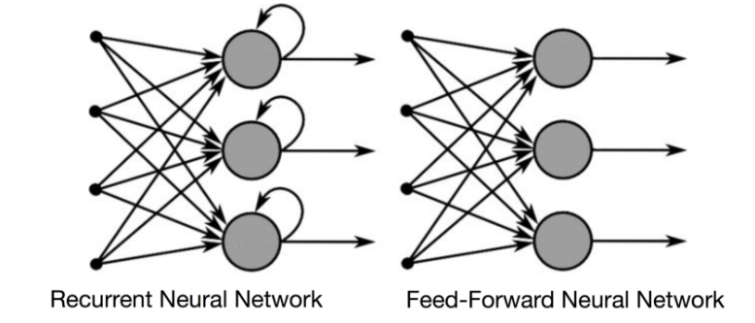
Difference between RNN and FFNN

Slide 4
Recurrent Neural Networks (RNN)
Recurrent neural networks (RNNs) are a class of neural network that are helpful in modeling sequence data.
Derived from feedforward networks, RNNs exhibit similar behavior to how human brains function.
Recurrent neural networks produce predictive results in sequential data that other algorithms can’t.
A usual RNN has a short-term memory.

Slide 5
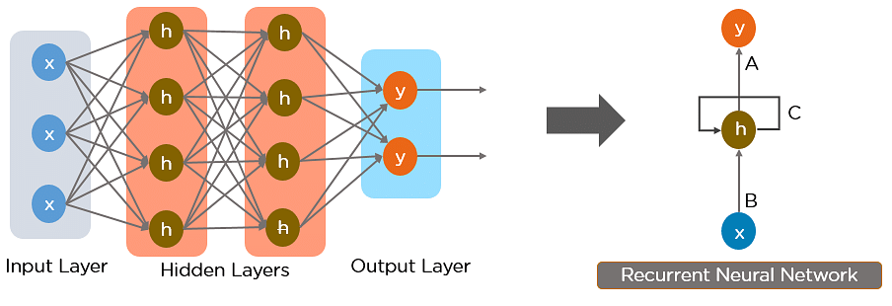
Simple Recurrent Neural Network

Slide 6
RNN works on the principle of saving the output of a particular layer and feeding this back to the input in order to predict the output of the layer.
The nodes in different layers of the neural network are compressed to form a single layer of recurrent neural networks. A, B, and C are the parameters of the network.

Slide 7
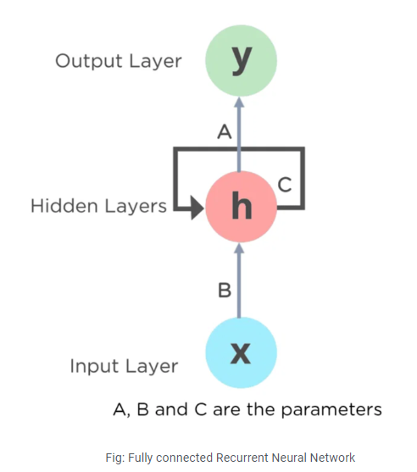
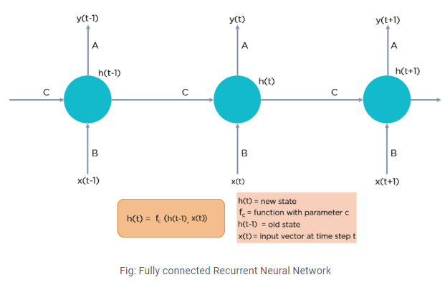

Slide 8
Here, “x” is the input layer, “h” is the hidden layer, and “y” is the output layer.
A, B, and C are the network parameters used to improve the output of the model.
At any given time t, the current input is a combination of input at x(t) and x(t-1).
The output at any given time is fetched back to the network to improve on the output.

Slide 9
How Does Recurrent Neural Networks Work?
The input layer ‘x’ takes in the input to the neural network and processes it and passes it onto the middle layer.
The middle layer ‘h’ can consist of multiple hidden layers, each with its own activation functions and weights and biases.
If you have a neural network where the various parameters of different hidden layers are not affected by the previous layer,
ie: the neural network does not have memory, then you can use a recurrent neural network.
The Recurrent Neural Network will standardize the different activation functions and weights and biases so that each hidden layer has the same parameters.
Then, instead of creating multiple hidden layers, it will create one and loop over it as many times as required.

Slide 10
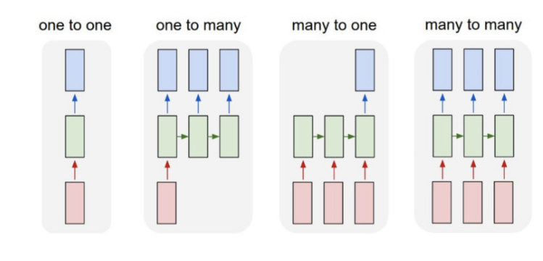
Types of Recurrent Neural Networks
One to One
One to Many
Many to One
Many to Many

Slide 11
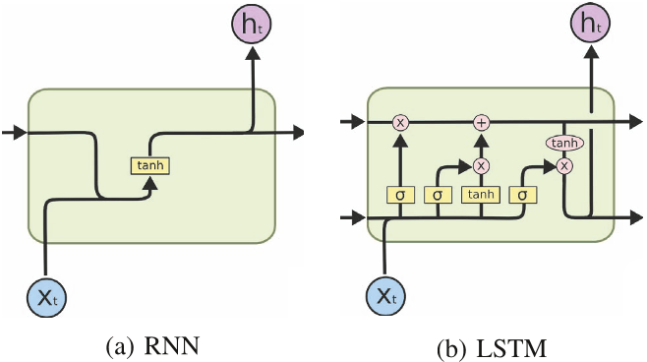
RNN vs LSTM

Slide 12
Long Short-Term Memory (LSTM)

Slide 13
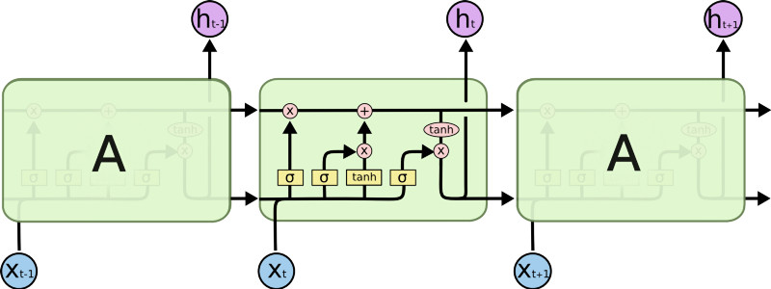
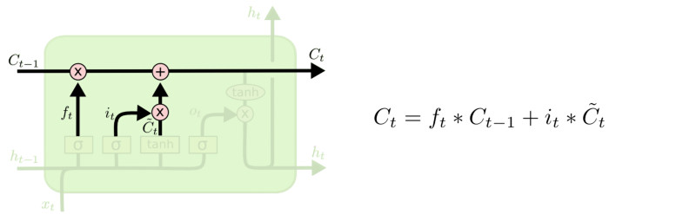
LSTM
This sigmoid gate
determines how much
information goes thru
Output gate
Controls what
goes into output
This decides what info
Is to add to the cell state
C_{t-1}
h_{t-1}
The core idea is this cell state C_{t}, it is changed slowly, with only minor linear interactions. It is very easy for information to flow along it unchanged.
Forget input
gate gate
Why sigmoid or tanh:
Sigmoid: 0,1 gating as switch.
Vanishing gradient problem in
LSTM is handled already.
ReLU replaces tanh ok?

Slide 14
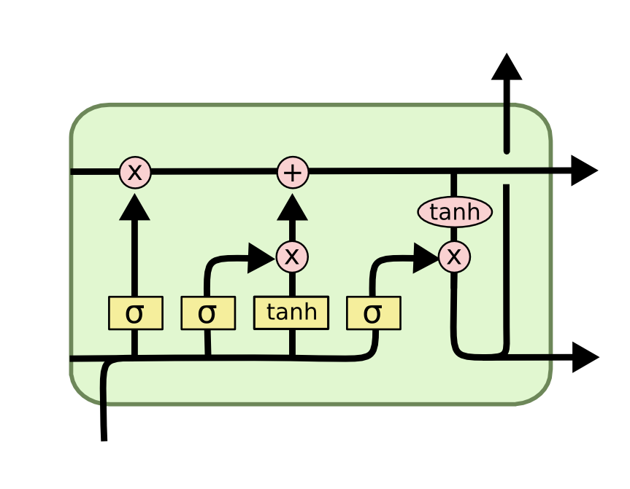
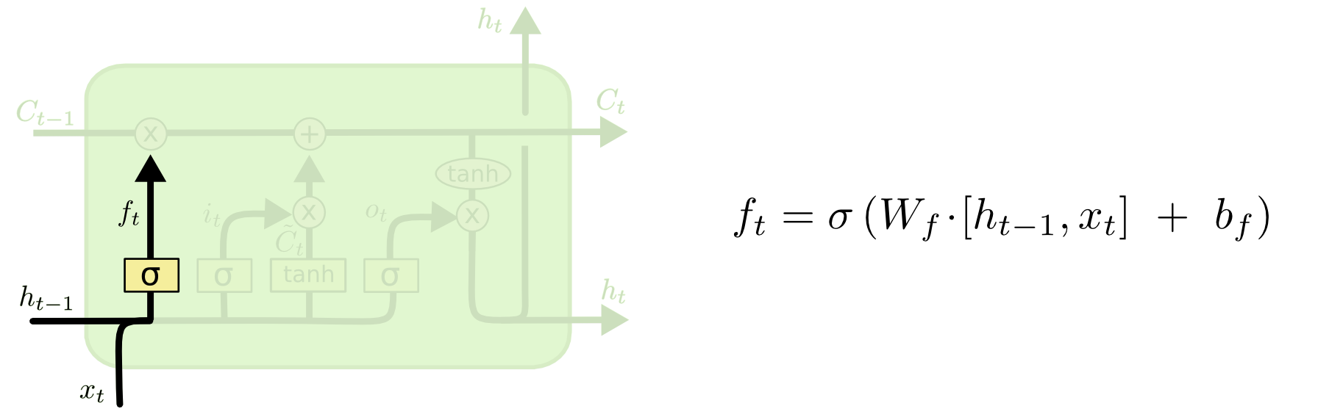
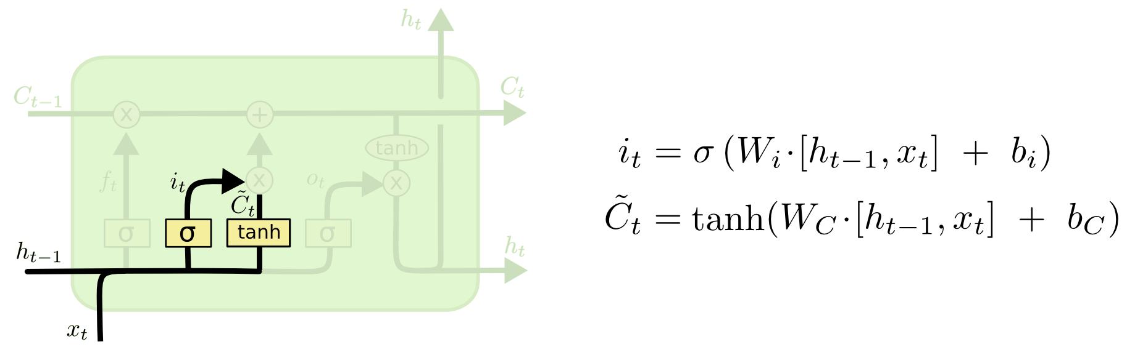
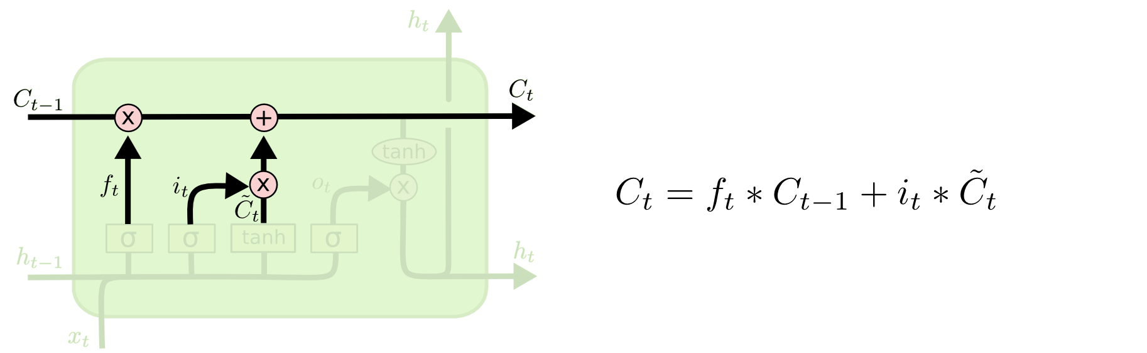
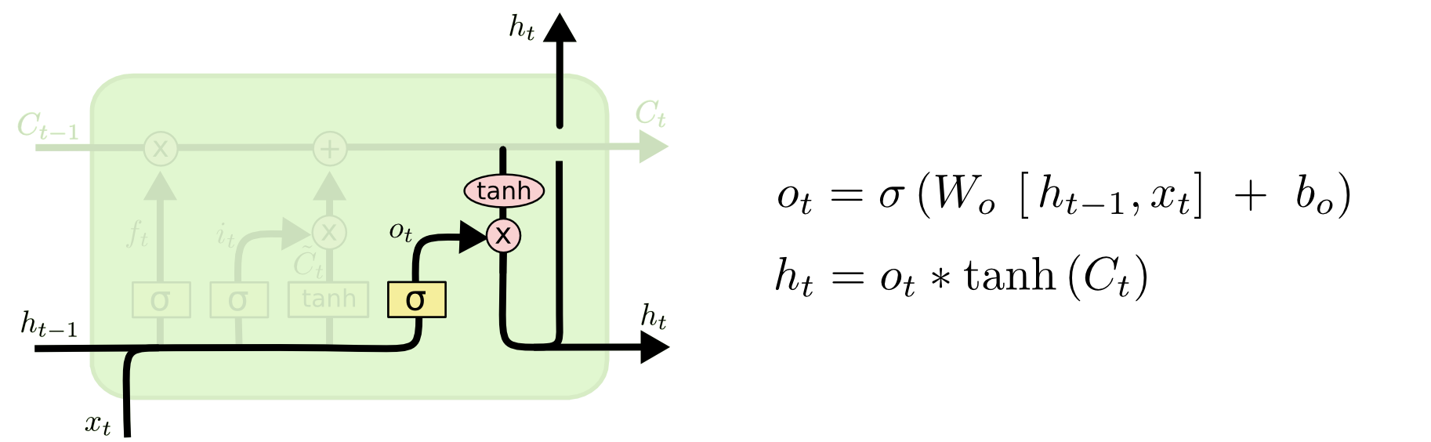
i_{t} decides what component
is to be updated.
C’_{t} provides change contents
Updating the cell state
Decide what part of the cell
state to output

Slide 15
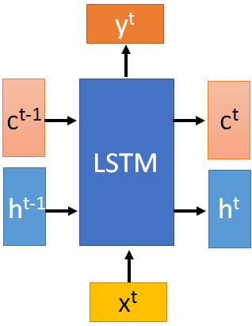

These 4 matrix
computation should
be done concurrently.
x^{t}
z
W
h^{t-1}
c^{t-1}
x^{t}
z^{i}
W^{i}
= σ( )
h^{t-1}
Controls
forget gate
Controls
input gate
Updating
information
Controls
Output gate
W^{f}
x^{t}
z^{f}
= σ( )
h^{t-1}
z^{f}
z^{i}
z
zº
x^{t}
zº
Wº
= σ( )
h^{t-1}
x^{t}
h^{t-1}
Information flow of LSTM

Slide 16
x^{t}
z
W
h^{t-1}
=tanh( )
c^{t-1}
c^{t-1}
diagonal
“peephole”
zº
z^{f}
z^{i}
obtained by the same way
z^{f}
z^{i}
z
zº
h^{t-1}
x^{t}
Information flow of LSTM

Slide 17




Element-wise multiply
y^{t}
c^{t-1}
c^{t}
c^{t} = z^{f}  c^{t-1} + z^{i}z
tanh
h^{t} = zº  tanh(c^{t})
y^{t} = σ(W’ h^{t})
z^{f}
z^{i}
z
zº
h^{t-1}
x^{t}
h^{t}
Information flow of LSTM

Slide 18



LSTM information flow
y^{t}
y^{t+1}
c^{t-1}
c^{t}
c^{t+1}
tanh
tanh
z^{f}
z^{i}
z
zº
z^{f}
z^{i}
z
zº
h^{t+1}
h^{t-1}
x^{t}
h^{t}
x^{t+1}
Information flow of LSTM

Slide 19
Transformer
The Transformer – a model that uses attention to boost the speed with which these models can be trained. The Transformer outperforms the Google Neural Machine Translation model in specific tasks. The biggest benefit, however, comes from how The Transformer lends itself to parallelization. It is in fact Google Cloud’s recommendation to use The Transformer as a reference model to use their Cloud TPU offering. So let’s try to break the model apart and look at how it functions.

Slide 20
The Transformer was proposed in the paper Attention is All You Need. A TensorFlow implementation of it is available as a part of the Tensor2Tensor package. Harvard’s NLP group created a guide annotating the paper with PyTorch implementation. In this post, we will attempt to oversimplify things a bit and introduce the concepts one by one to hopefully make it easier to understand to people without in-depth knowledge of the subject matter.

Slide 21
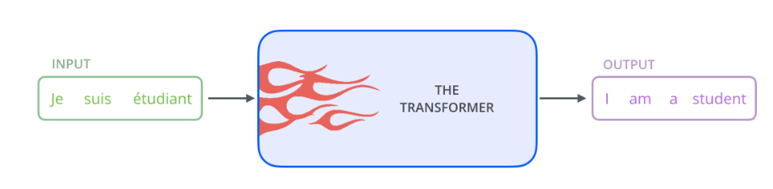
In a machine translation application, it would take a sentence in one language, and output its translation in another.

Slide 22
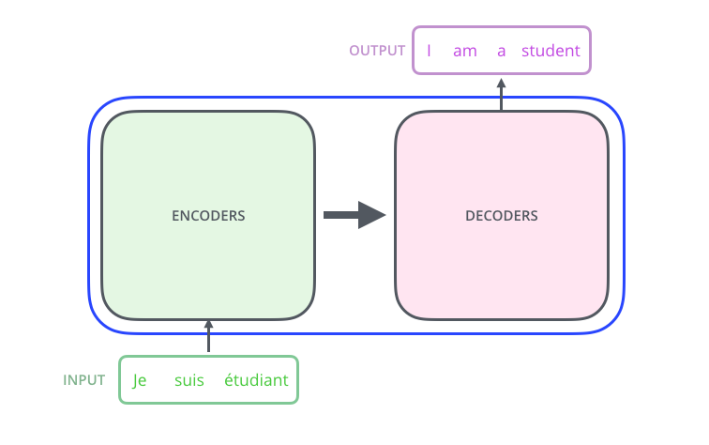
An encoding component, a decoding component, and connections between them.

Slide 23
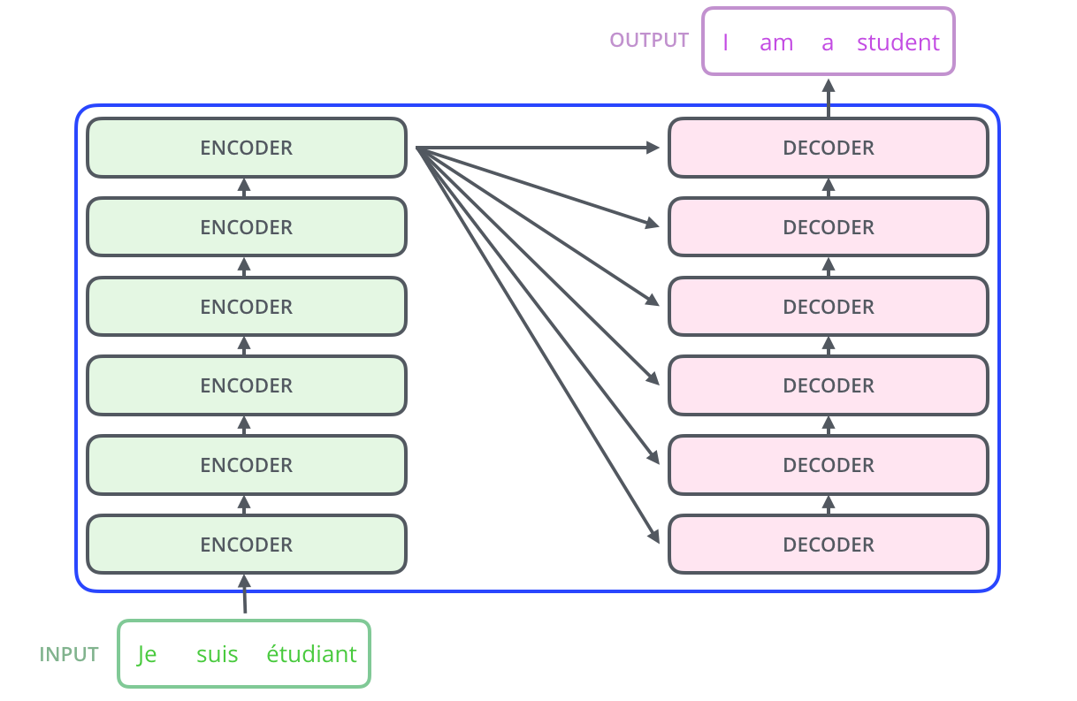
The encoding component is a stack of encoders (the paper stacks six of them on top of each other – there’s nothing magical about the number six, one can definitely experiment with other arrangements). The decoding component is a stack of decoders of the same number.

Slide 24
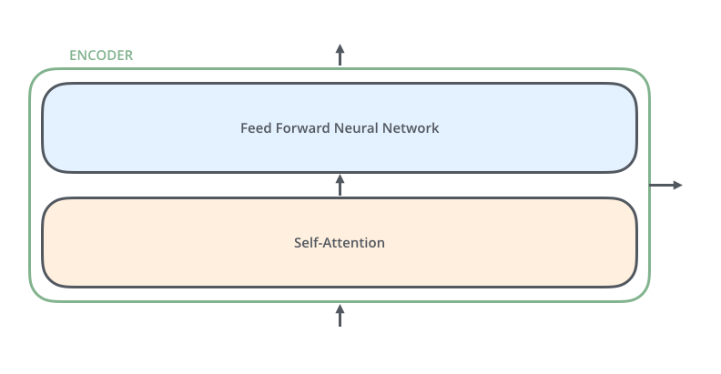
The encoders are all identical in structure (yet they do not share weights). Each one is broken down into two sub-layers:

Slide 25
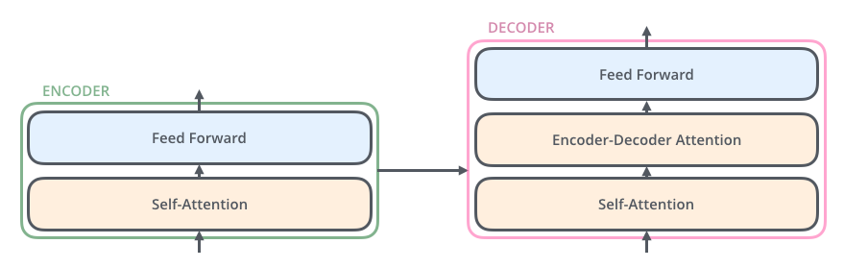
The encoder’s inputs first flow through a self-attention layer – a layer that helps the encoder look at other words in the input sentence as it encodes a specific word.
The outputs of the self-attention layer are fed to a feed-forward neural network. The exact same feed-forward network is independently applied to each position.
The decoder has both those layers, but between them is an attention layer that helps the decoder focus on relevant parts of the input sentence.

Slide 26
BERT Model
BERT, an acronym for Bidirectional Encoder Representations from Transformers, stands as an open-source machine learning framework designed for the realm of natural language processing (NLP). Originating in 2018, this framework was crafted by researchers from Google AI Language. The article aims to explore the architecture, working and applications of BERT.

Slide 27
BERT (Bidirectional Encoder Representations from Transformers) leverages a transformer-based neural network to understand and generate human-like language. BERT employs an encoder-only architecture. In the original Transformer architecture, there are both encoder and decoder modules. The decision to use an encoder-only architecture in BERT suggests a primary emphasis on understanding input sequences rather than generating output sequences.

Slide 28
Bidirectional Approach of BERT
Traditional language models process text sequentially, either from left to right or right to left.
This method limits the model’s awareness to the immediate context preceding the target word.
BERT uses a bi-directional approach considering both the left and right context of words in a sentence, instead of analyzing the text sequentially, BERT looks at all the words in a sentence simultaneously.

Slide 29
Example: “The bank is situated on the _______ of the river.”
In a unidirectional model, the understanding of the blank would heavily depend on the preceding words, and the model might struggle to discern whether “bank” refers to a financial institution or the side of the river.
BERT, being bidirectional, simultaneously considers both the left (“The bank is situated on the”) and right context (“of the river”), enabling a more nuanced understanding. It comprehends that the missing word is likely related to the geographical location of the bank, demonstrating the contextual richness that the bidirectional approach brings.

Slide 30
Pre-training and Fine-tuning
The BERT model undergoes a two-step process:
Pre-training on Large amounts of unlabeled text to learn contextual embeddings.
Fine-tuning on labeled data for specific NLP tasks.

Slide 31
Pre-Training on Large Data
BERT is pre-trained on large amount of unlabeled text data. The model learns contextual embeddings, which are the representations of words that take into account their surrounding context in a sentence.
BERT engages in various unsupervised pre-training tasks. For instance, it might learn to predict missing words in a sentence (Masked Language Model or MLM task), understand the relationship between two sentences, or predict the next sentence in a pair.
Fine-Tuning on Labeled Data
After the pre-training phase, the BERT model, armed with its contextual embeddings, is then fine-tuned for specific natural language processing (NLP) tasks. This step tailors the model to more targeted applications by adapting its general language understanding to the nuances of the particular task.
BERT is fine-tuned using labeled data specific to the downstream tasks of interest. These tasks could include sentiment analysis, question-answering, named entity recognition, or any other NLP application. The model’s parameters are adjusted to optimize its performance for the particular requirements of the task at hand.

Slide 32
How BERT work?
BERT is designed to generate a language model so, only the encoder mechanism is used. Sequence of tokens are fed to the Transformer encoder.
These tokens are first embedded into vectors and then processed in the neural network.
The output is a sequence of vectors, each corresponding to an input token, providing contextualized representations.
When training language models, defining a prediction goal is a challenge. Many models predict the next word in a sequence, which is a directional approach and may limit context learning.
BERT addresses this challenge with two innovative training strategies:
Masked Language Model (MLM)
Next Sentence Prediction (NSP)

Slide 33
In BERT’s pre-training process, a portion of words in each input sequence is masked and the model is trained to predict the original values of these masked words based on the context provided by the surrounding words.
Masking words: Before BERT learns from sentences, it hides some words (about 15%) and replaces them with a special symbol, like [MASK].
Guessing Hidden Words: BERT’s job is to figure out what these hidden words are by looking at the words around them. It’s like a game of guessing where some words are missing, and BERT tries to fill in the blanks.
How BERT learns:
BERT adds a special layer on top of its learning system to make these guesses. It then checks how close its guesses are to the actual hidden words.
It does this by converting its guesses into probabilities, saying, “I think this word is X, and I’m this much sure about it.”
Special Attention to Hidden Words
3. BERT’s main focus during training is on getting these hidden words right. It cares less about predicting the words that are not hidden.
This is because the real challenge is figuring out the missing parts, and this strategy helps BERT become really good at understanding the meaning and context of words.

Slide 34
In technical terms,
BERT adds a classification layer on top of the output from the encoder. This layer is crucial for predicting the masked words.
The output vectors from the classification layer are multiplied by the embedding matrix, transforming them into the vocabulary dimension. This step helps align the predicted representations with the vocabulary space.
The probability of each word in the vocabulary is calculated using the SoftMax activation function. This step generates a probability distribution over the entire vocabulary for each masked position.
The loss function used during training considers only the prediction of the masked values. The model is penalized for the deviation between its predictions and the actual values of the masked words.
The model converges slower than directional models. This is because, during training, BERT is only concerned with predicting the masked values, ignoring the prediction of the non-masked words. The increased context awareness achieved through this strategy compensates for the slower convergence.

Slide 35
2. Next Sentence Prediction (NSP)
BERT predicts if the second sentence is connected to the first. This is done by transforming the output of the [CLS] token into a 2×1 shaped vector using a classification layer, and then calculating the probability of whether the second sentence follows the first using SoftMax.

Slide 36
In the training process, BERT learns to understand the relationship between pairs of sentences, predicting if the second sentence follows the first in the original document.
50% of the input pairs have the second sentence as the subsequent sentence in the original document, and the other 50% have a randomly chosen sentence.
To help the model distinguish between connected and disconnected sentence pairs. The input is processed before entering the model:
A [CLS] token is inserted at the beginning of the first sentence, and a [SEP] token is added at the end of each sentence.
A sentence embedding indicating Sentence A or Sentence B is added to each token.
A positional embedding indicates the position of each token in the sequence.
BERT predicts if the second sentence is connected to the first. This is done by transforming the output of the [CLS] token into a 2×1 shaped vector using a classification layer, and then calculating the probability of whether the second sentence follows the first using SoftMax.

Slide 37
During the training of BERT model, the Masked LM and Next Sentence Prediction are trained together.
The model aims to minimize the combined loss function of the Masked LM and Next Sentence Prediction, leading to a robust language model with enhanced capabilities in understanding context within sentences and relationships between sentences.

Slide 38
BERT Architectures
The architecture of BERT is a multilayer bidirectional transformer encoder which is quite similar to the transformer model. A transformer architecture is an encoder-decoder network that uses self-attention on the encoder side and attention on the decoder side.
BERT_{BASE} has 12 layers in the Encoder stack while BERT_{LARGE} has 24 layers in the Encoder stack. These are more than the Transformer architecture described in the original paper (6 encoder layers).
BERT architectures (BASE and LARGE) also have larger feedforward networks (768 and 1024 hidden units respectively), and more attention heads (12 and 16 respectively) than the Transformer architecture suggested in the original paper. It contains 512 hidden units and 8 attention heads.
BERT_{BASE} contains 110M parameters while BERT_{LARGE} has 340M parameters.

Slide 39
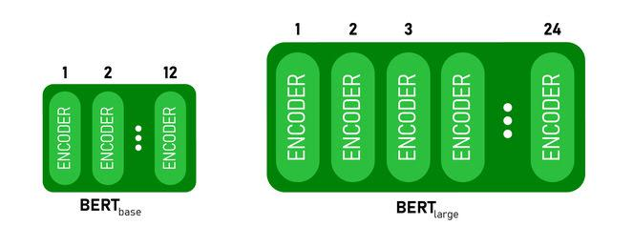
BERT BASE and BERT LARGE architecture.

Slide 40
This model takes the CLS token as input first, then it is followed by a sequence of words as input. Here CLS is a classification token.
It then passes the input to the above layers. Each layer applies self-attention and passes the result through a feedforward network after then it hands off to the next encoder.
The model outputs a vector of hidden size (768 for BERT BASE).
If we want to output a classifier from this model we can take the output corresponding to the CLS token.

Slide 41
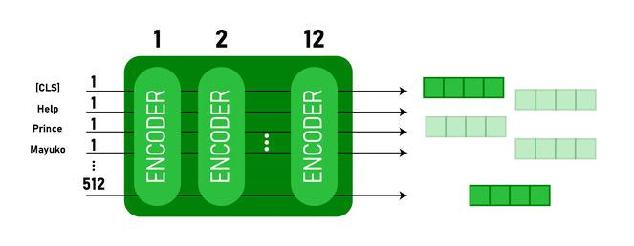
Now, this trained vector can be used to perform a number of tasks such as classification, translation, etc. For Example, the paper achieves great results just by using a single layer Neural Network on the BERT model in the classification task.

Slide 42
RoBERTa
Despite the excellent performance of BERT, researchers still continued experimenting with its configuration in hopes of achieving even better metrics.
Fortunately, they succeeded with it and presented a new model called RoBERTa — Robustly Optimised BERT Approach.
RoBERTa (short for “Robustly Optimized BERT Approach”) is a variant of the BERT (Bidirectional Encoder Representations from Transformers) model, which was developed by researchers at Facebook AI.
Like BERT, RoBERTa is a transformer-based language model that uses self-attention to process input sequences and generate contextualized representations of words in a sentence.

Slide 43
One key difference between RoBERTa and BERT is that RoBERTa was trained on a much larger dataset and using a more effective training procedure.
In particular, RoBERTa was trained on a dataset of 160GB of text, which is more than 10 times larger than the dataset used to train BERT.
Additionally, RoBERTa uses a dynamic masking technique during training that helps the model learn more robust and generalizable representations of words.
RoBERTa has been shown to outperform BERT and other state-of-the-art models on a variety of natural language processing tasks, including language translation, text classification, and question answering.
It has also been used as a base model for many other successful NLP models and has become a popular choice for research and industry applications.
Overall, RoBERTa is a powerful and effective language model that has made significant contributions to the field of NLP and has helped to drive progress in a wide range of applications.

Slide 44
RoBERTa stands for Robustly Optimized BERT Pre-training Approach. It was presented by researchers at Facebook and Washington University.
The goal of this paper was to optimize the training of BERT architecture in order to take lesser time during pre-training.

Slide 45
Modifications to BERT:
RoBERTa has almost similar architecture as compare to BERT, but in order to improve the results on BERT architecture, the authors made some simple design changes in its architecture and training procedure. These changes are:
Removing the Next Sentence Prediction (NSP) objective: In the next sentence prediction, the model is trained to predict whether the observed document segments come from the same or distinct documents via an auxiliary Next Sentence Prediction (NSP) loss. The authors experimented with removing/adding of NSP loss to different versions and concluded that removing the NSP loss matches or slightly improves downstream task performance

Slide 46
Training with bigger batch sizes & longer sequences: Originally BERT is trained for 1M steps with a batch size of 256 sequences. In this paper, the authors trained the model with 125 steps of 2K sequences and 31K steps with 8k sequences of batch size. This has two advantages, the large batches improves perplexity on masked language modelling objective and as well as end-task accuracy. Large batches are also easier to parallelize via distributed parallel training.
Dynamically changing the masking pattern: In BERT architecture, the masking is performed once during data preprocessing, resulting in a single static mask. To avoid using the single static mask, training data is duplicated and masked 10 times, each time with a different mask strategy over 40 epochs thus having 4 epochs with the same mask. This strategy is compared with dynamic masking in which different masking is generated every time we pass data into the model.

Slide 47
Datasets Used:
The following are the datasets used to train ROBERTa model:
BOOK CORPUS and English Wikipedia dataset: This data also used for training BERT architecture, this data contains 16GB of text.
CC-NEWS. This data contains 63 million English news articles crawled between September 2016 and February 2019. The size of this dataset is 76 GB after filtering.
OPENWEBTEXT: This dataset contains web content extracted from the URLs shared on Reddit with at least 3 upvotes. The size of this dataset is 38 GB.
STORIES: This dataset contains a subset of Common Crawl data filtered to match the story-like style of Winograd NLP task. This dataset contains 31 GB of text.

Slide 48
Fine-tuning For Downstream Tasks
Adapting BERT for downstream tasks entails utilizing the pre-trained BERT model and customizing it for a particular task by adding a layer on top and training it on the target task.
This technique allows the model to learn dependent on the task details from the data used for training while drawing on the knowledge of broad language expression of the pre-trained BERT model. Use the hugging face transformers package in Python to fine-tune BERT.
Describe your training data, incorporating input text and labels. Fine-tuning the pre-trained BERT model for downstream tasks according to your data using the fit() function from the BertForSequenceClassification class.

Slide 49
How BERT Undergoes Fine-Tuning?
Fine-tuning BERT adapts a pre-trained model with training data from the desired job to a specific downstream task by training a new layer.
This process empowers the model to gain task-specific knowledge and enhance its performance on the target task.

Slide 50
Primary steps in the fine-tuning process for BERT
1: Utilize the hugging face transformers library to load the pre-trained BERT model and tokenizer.
import torch
# Choose the appropriate device based on availability (CUDA or CPU)
gpu_available = torch.cuda.is_available()
device = torch.device("cuda" if gpu_available else "cpu")
# Utilize a different tokenizer
from transformers import AutoTokenizer
tokenizer = AutoTokenizer.from_pretrained('bert-base-uncased')
# Load the model using a custom function
from transformers import AutoModelForSequenceClassification
model = AutoModelForSequenceClassification.from_pretrained('bert-base-uncased')
model.to(device)

Slide 51
2: Specify the training data for the specific target task,encompassing the input text and their corresponding labels
# Specify the input text and the corresponding labels
input_text = "This is a sample input text"
labels = [1]
3: Utilize the BERT tokenizer to tokenize the input text
# Tokenize the input text
input_ids =torch.tensor(tokenizer.encode(input_text)).unsqueeze(0)
4: Put the model in training mode.
# Set the model to training mode
model.train()

Slide 52
Step 5: For obtaining fine-tuning of the pre-trained BERT model, we use the method of Bert For Sequence Classification class. it includes training a new layer of pre-trained BERT model with the target task’s training data.
# Set up your dataset, batch size, and other training hyperparameters
dataset_train = ...
lot_size = 32
num_epochs = 3
learning_rate = 2e-5
# Create the data loader for the training set
train_dataloader = torch.
utils.data.
DataLoader(dataset_train,
batch_size=lot_size)
model.fit(train_dataloader,num_epochs=num_epochs, learning_rate=learning_rate)

Slide 53
Step 6: Investigate the fine-tuned BERT model’s illustration on the specific target task.
# Switch the model to evaluation mode
model.eval()
# Calculate the logits (unnormalized probabilities) for the input text
with torch.no_grad():
logits = model(input_ids)
# Use the logits to generate predictions for the input text
predictions = logits.argmax(dim=-1)
accuracy = ...

Slide 54
These represent the primary steps involved in fine-tuning BERT for a downstream task. You can utilize this as a foundation and customize it according to your specific use case.
Fine-tuning BERT enables the model to acquire task-specific information, enhancing its performance on the target task. It proves particularly valuable when the target task involves a relatively small dataset, as fine-tuning w ith the small dataset allows the model to learn task-specific information that might not be attainable from the pre-trained BERT model alone.

Slide 55
Which Layers Undergo Modifications During Fine-tuning?
During fine-tuning, solely the weights of the supplementary layer appended to the pre-trained BERT model undergo updates. The weights of the pre-trained BERT model remain fixed. Thus only the added layer experiences modifications throughout the fine-tuning process.
Typically, the attached layer functions as a classification layer proceeds the pre-trained BERT model results, and generates logits for each class in the end task. The target task’s training data trains the added layer, enabling it to acquire task-specific information and improve the model’s performance on the target task.
To sum up, during fine-tuning, the added layer above the pre-trained BERT model undergoes modifications. The pre-trained BERT model maintains fixed weights. Thus, only the added layer is subject to updates during the training process.

Slide 56
Downstream Tasks
Downstream tasks include a variety of natural language processing (NLP) operations that use pre-trained language reconstruction models such as BERT.
Text Classification
Text classification involves the assignment of a text to predefined categories or labels. For instance, one can train a text classification model to categorize movie reviews as positive or negative.
Use the BertForSequenceClassification library to alter BERT for text classification. This class uses input data, such as words or paragraphs, to generate logits for every class.

